Slide 1


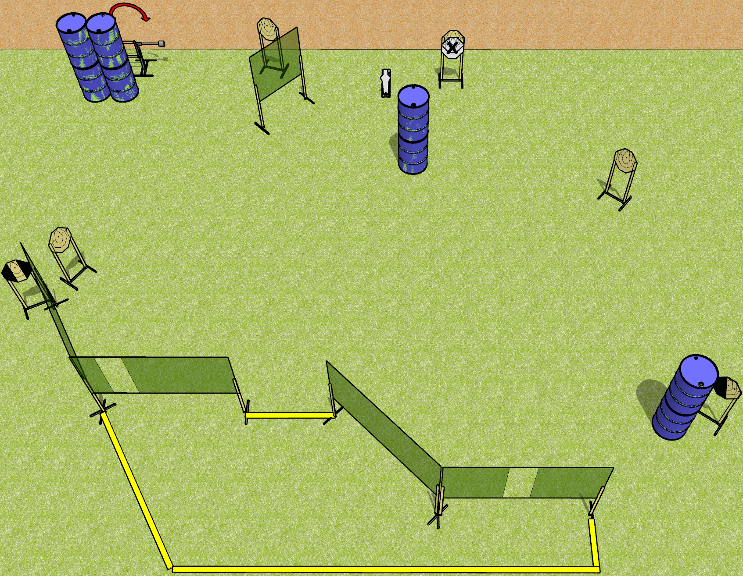
 | Dothan Gun Club – USPSA Match I Wish Course Designer : Drew Coleman
Round Count 15 rounds 7 IPSC 1 mini popper
Equipment List 10 wall feet 1 medium fault line, 1 3ft fault line Long fault lines should all be 10’ 1 tux, 1 left diagonal

Slide 2
I Wish
Written Stage Briefing
I Wish is a 15 round, 75 point, Comstock course of fire. There are 7 IPSC targets and 1 mini popper. The best 2 hits on paper will score, and steel must fall to score. The start signal is audible.
The swinger is activated by the mini popper and remains visible at rest.
Handgun start position is inside the shooting area, wrists below belt. Handgun is loaded and holstered.
PCC start position is inside the shooting area, stock on belt. Loaded carbine is held with both hands, safety on.
On start signal engage targets as they become available from within the shooting area.

Slide 3
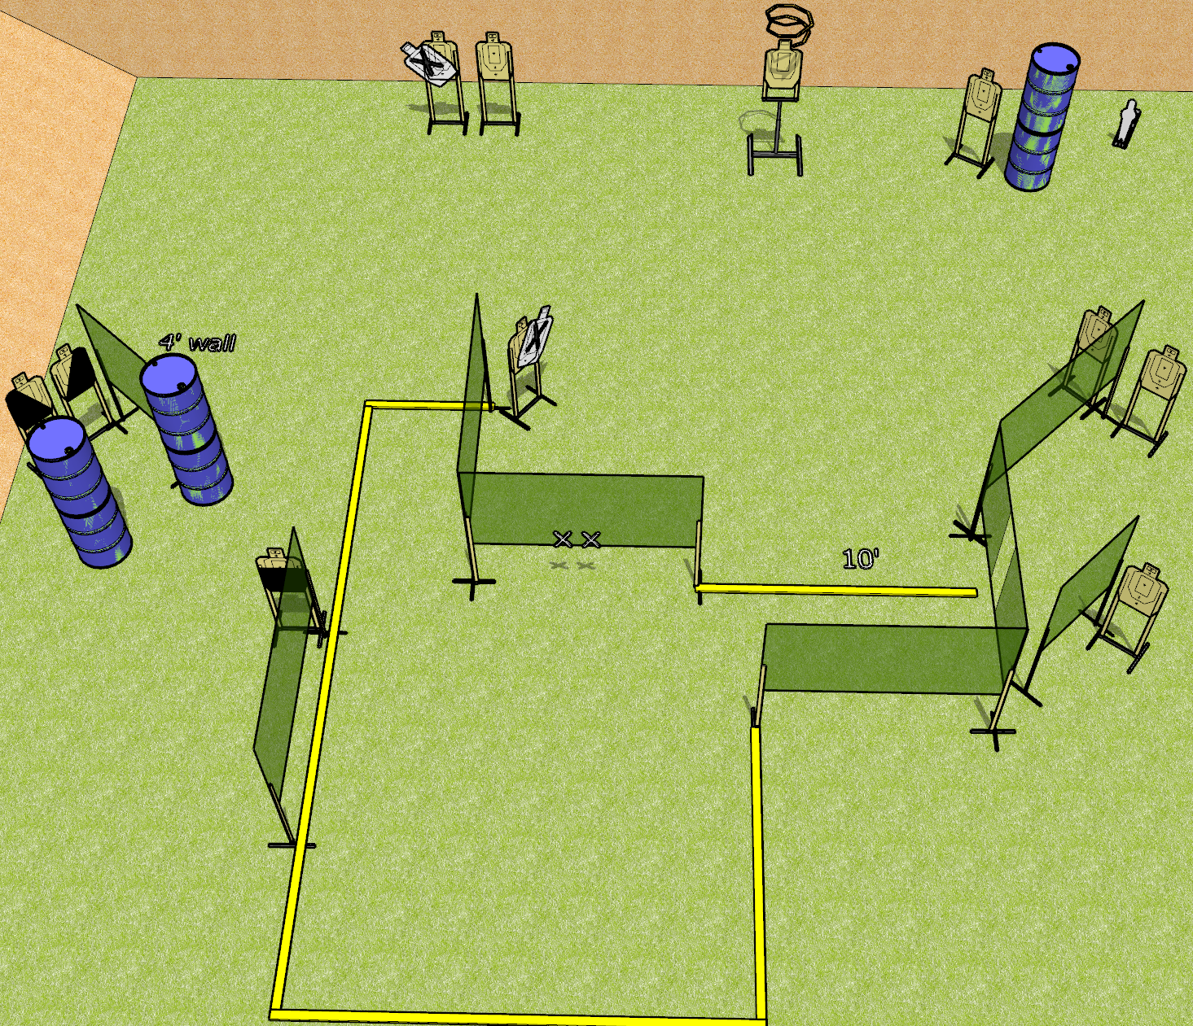
 | Dothan Gun Club – USPSA Match So Much To Do Course Designer : Drew Coleman
Round Count 23 rounds 11 USPSA targets 1 mini popper
Equipment List 14 wall feet 2 medium wall feet Drop turner + activator 1 50%, 1 left and 1 right diagonal

Slide 4
So Much To Do
Written Stage Briefing
So Much To Do is a 23 round, 115 point, Comstock course of fire. There are 11 USPSA targets and 1 mini popper. The best 2 hits on paper will score, and steel must fall to score. The start signal is audible.
The drop turner is activated by the mini popper and is visible at rest.
Handgun start position is hands touching marks. Handgun is loaded and holstered.
PCC start position is muzzle touching either mark, stock on belt. Loaded carbine is held with both hands, safety on.
On start signal, engage targets as they become available from within the shooting area.

Slide 5
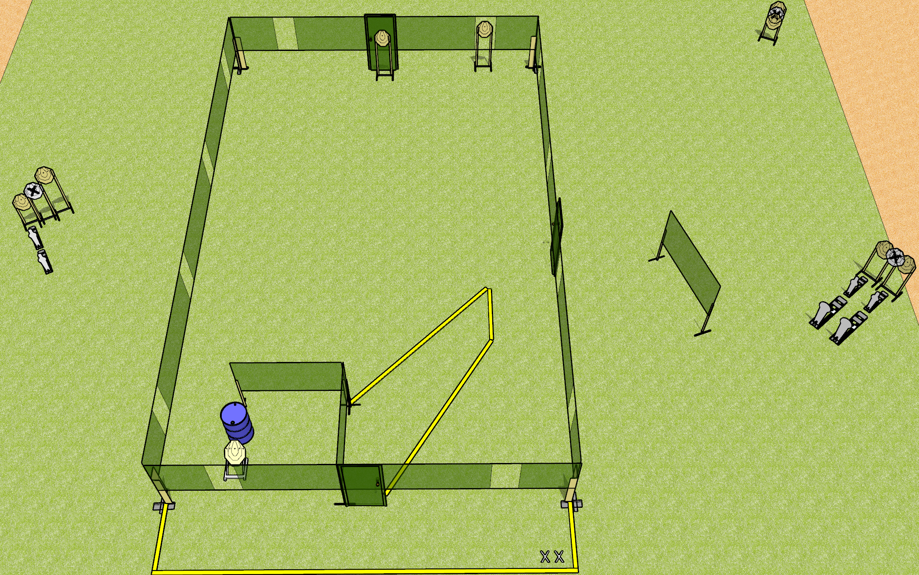
 | Dothan Gun Club – USPSA Match Free Disorientation Course Designer : Patrick Free
Round Count 24 rounds 9 IPSC 2 colt poppers, 4 mini poppers
Equipment List 3 medium fault lines 2 wall feet

Slide 6
Free Disorientation
Written Stage Briefing
Free Disorientation is a 24 round, 120 point, Comstock course of fire. There are 9 IPSC targets, 2 colt poppers, and 4 mini poppers. The best 2 hits on paper will score, and steel must fall to score. The start signal is audible.
Handgun start position is both feet on X’s, wrists above shoulders. Handgun is unloaded and holstered.
PCC start position is both feet on X’s, stock on belt. Unloaded carbine is held with both hands.
On start signal, engage targets as they become available from within the shooting area.

Slide 7
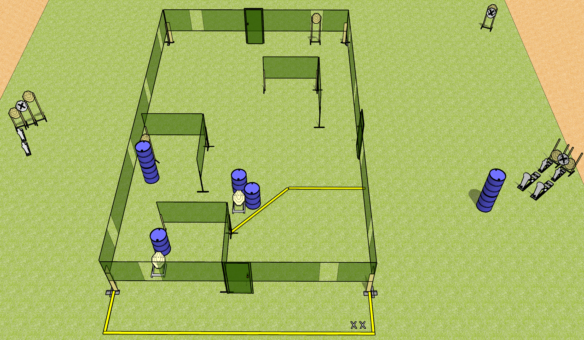
 | Dothan Gun Club – USPSA Match Free Disorientation Course Designer : Patrick Free/Drew Coleman
Round Count 24 rounds 9 IPSC 2 colt poppers, 4 mini poppers
Equipment List 3 medium fault lines

Slide 8
Free Disorientation
Written Stage Briefing
Free Disorientation is a 24 round, 120 point, Comstock course of fire. There are 9 IPSC targets, 2 colt poppers, and 4 mini poppers. The best 2 hits on paper will score, and steel must fall to score. The start signal is audible.
Handgun start position is both feet on X’s, wrists above shoulders. Handgun is holstered with loaded magazine, empty chamber, hammer down.
PCC start position is both feet on X’s, stock on belt. Carbine is held with both hands, magazine inserted, empty chamber, hammer down.
On start signal, engage targets as they become available from within the shooting area.

Slide 9
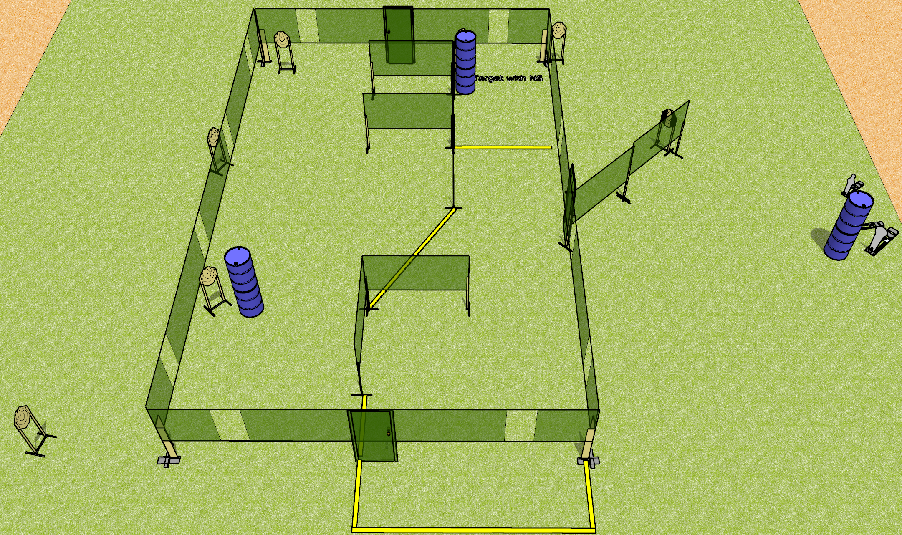
 | Dothan Gun Club – USPSA Match Unexpected Detour Course Designer : Drew Coleman
Round Count 24 rounds 7 IPSC 1 colt popper, 2 mini poppers
Equipment List 3 medium fault lines 3 wall feet 1 tuxedo

Slide 10
Unexpected Detour
Written Stage Briefing
Unexpected Detour is a 24 round, 120 point, Comstock course of fire. There are 7 IPSC targets, 1 colt popper, and 2 mini poppers. The best 3 hits on paper will score, and steel must fall to score. The start signal is audible.
Handgun start position is completely outside the shooting area, wrists below belt. Handgun is loaded and holstered.
PCC start position is completely outside the shooting area, stock on belt. Loaded carbine is held with both hands, safety on.
On start signal, engage target as they become available from within the shooting area.

Slide 11
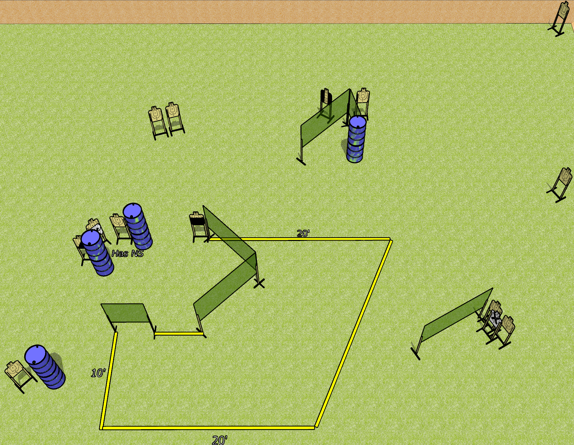
 | Dothan Gun Club – USPSA Match Throttle Control Course Designer : Drew Coleman
Round Count 26 rounds 13 USPSA targets
Equipment List 10 wall feet 2 medium fault lines 1 50%, 1 left diagonal, 1 tuxedo

Slide 12
Throttle Control
Written Stage Briefing
Throttle Control is a 26 round, 130 point, Comstock course of fire. There are 13 USPSA targets. The best 2 hits on paper will score, and steel must fall to score. The start signal is audible.
Handgun start position is inside the shooting area, wrists below belt. Handgun is loaded and holstered.
PCC start position is inside the shooting area, stock on belt. Loaded carbine is held with both hands, safety on.
On start signal, engage targets as they become available from within the shooting area.

Slide 13
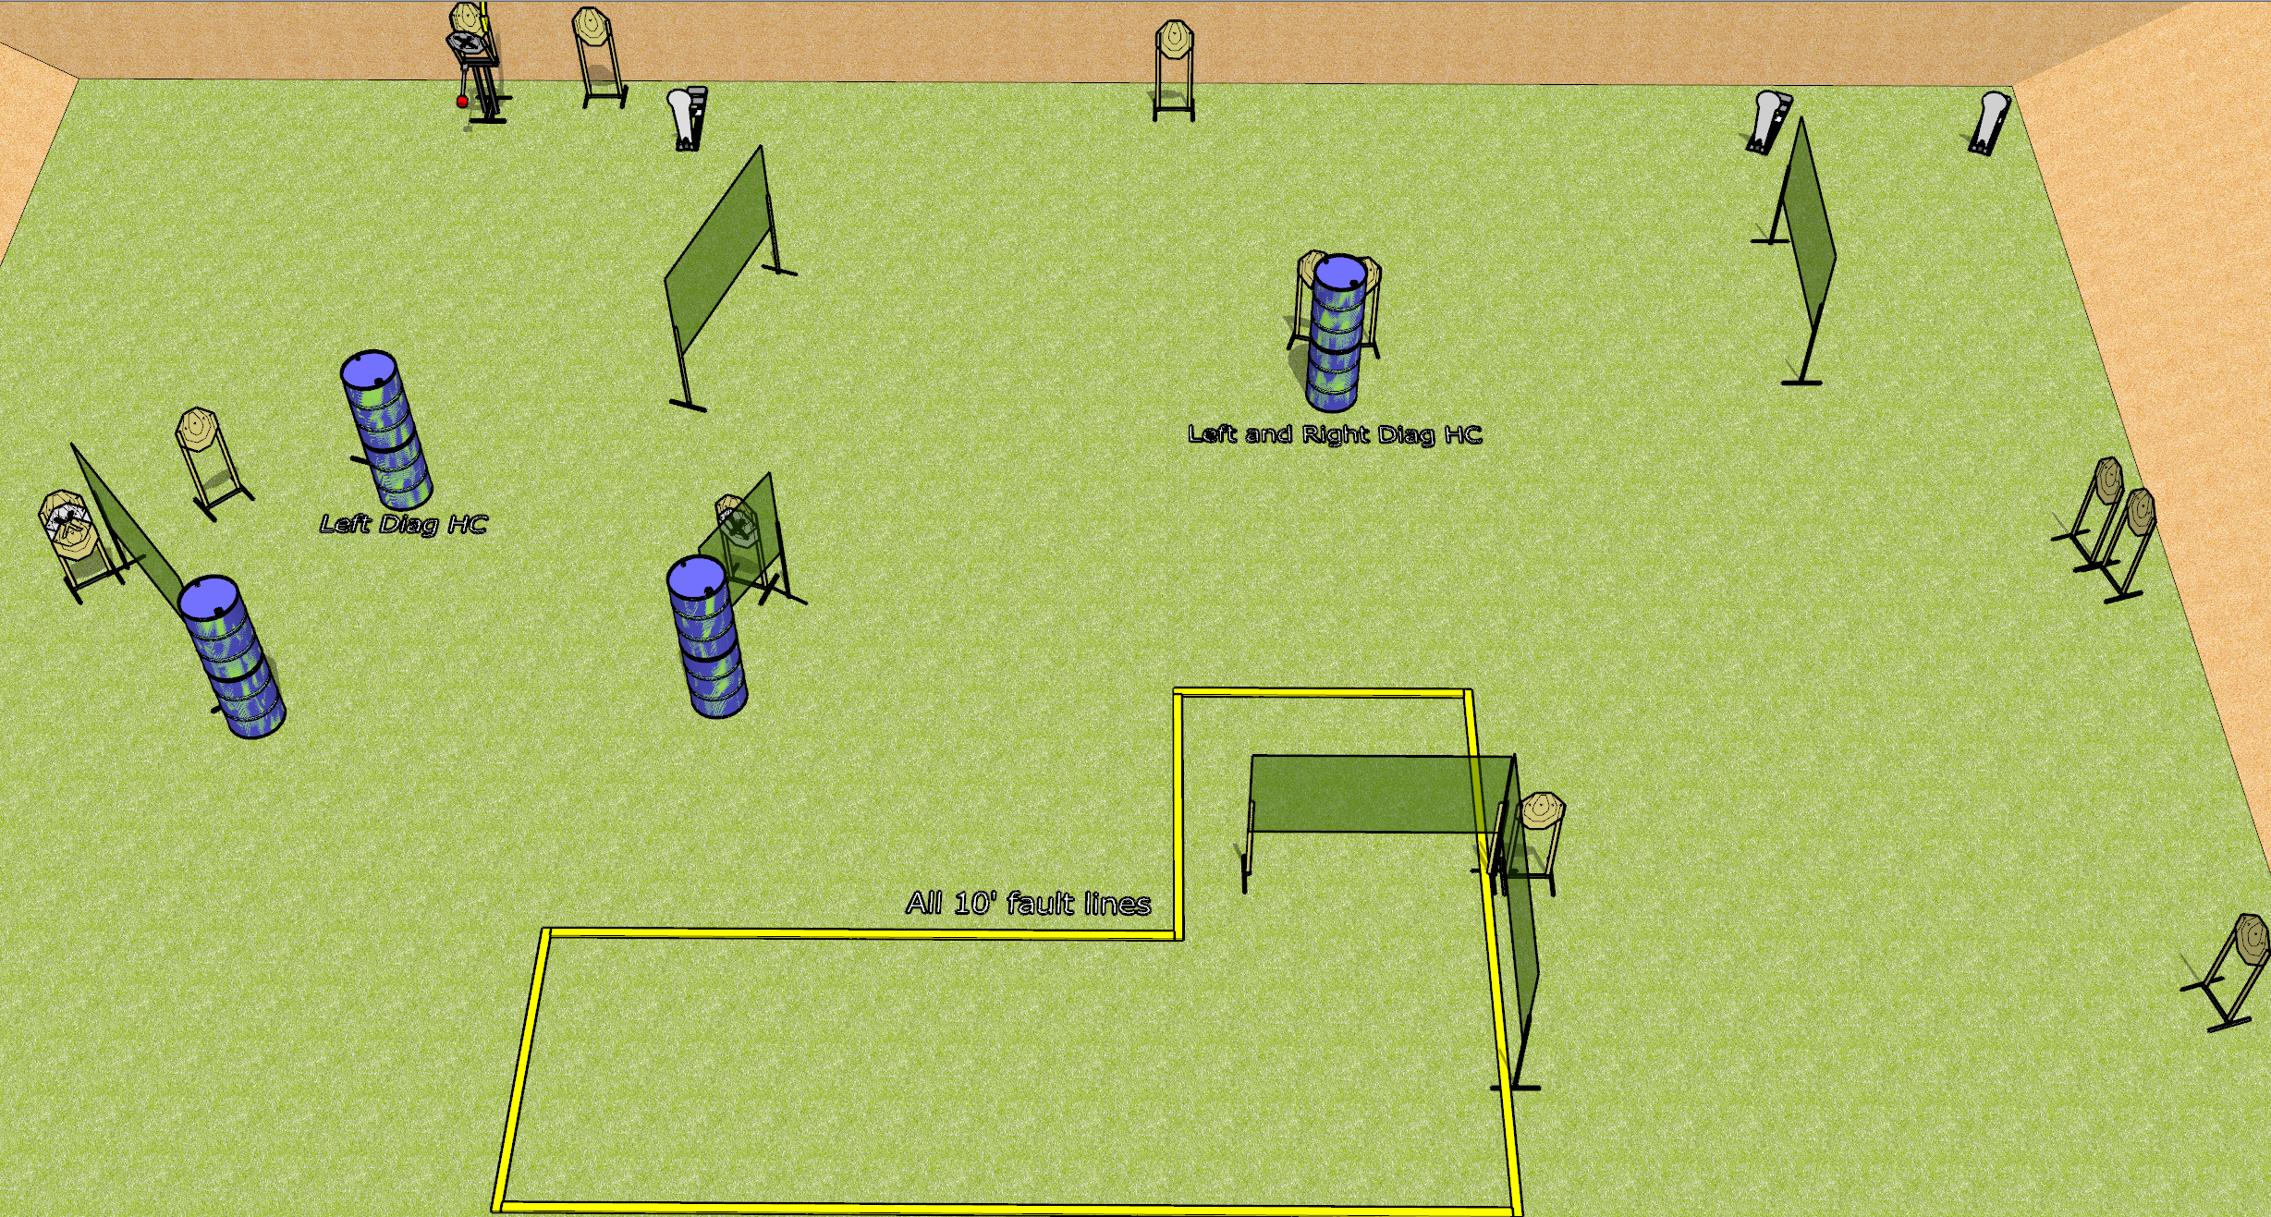
 | Dothan Gun Club – USPSA Match Big Expectations Course Designer : Drew Coleman
Round Count 31 rounds 14 IPSC 3 Colt poppers
Equipment List 11 wall feet 10 10’ fault lines Max trap + activator 2 left diag, 1 right diag

Slide 14
Big Expectations
Written Stage Briefing
Big Expectations is a 31 round, 155 point, Comstock course of fire. There are 14 IPSC targets and 3 colt poppers. The best 2 hits on paper will score, and steel must fall to score. The start signal is audible.
The Max Trap is activated by the left colt popper and remains visible at rest.
Handgun start position is inside the shooting area, wrists below belt. Handgun is loaded and holstered.
PCC start position is inside the shooting area, stock on belt. Loaded carbine is held with both hands, safety on.
On start signal, engage targets as they become available from within the shooting area.

